Slide 1

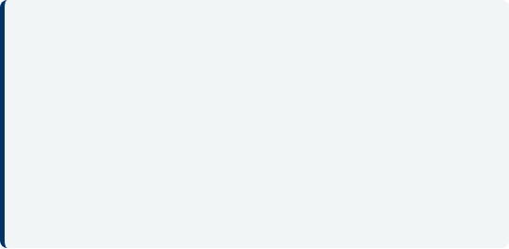
DocuTrack
Team Members
Student 1: Roll No - 2500031529 Ayan Roy
Student 2: Roll No - 2500030880 Mun Mun Nayak
Student 3: Roll No - 2500030888 Kundan Kumar
Section : S3
Academic Year : 2025-26
Faculty Mentor
Dr. Sreedhar Burada

Slide 2
Problem Statement & Objective
Problem Statement
Objectives
DocuTrack solves the problem of managing, indexing, and analyzing large document pools efficiently. It provides quick lookups, identifies relationships, and optimizes operations using advanced DSA, mimicking a real-world document tracking ecosystem.
Implement Core Data Structures (BST, AVL, Graph, Tries) for document management.
Demonstrate Path Optimization and Storage Algorithms (Dijkstra, Knapsack, LIS).
Deliver a robust, cohesive console application uniting all 6 CO modules.
Target Users
Students, Administrators, and Developers learning applied DSA.

Slide 3






Technologies & Concepts Used
Development Stack
Core Java Concepts
Additional Tools
Language: Java
Data Structures (BST, AVL, Graph)
Java Collections Framework
Platform: Console / Desktop
Graph Traversals (BFS, DFS)
Storage Optimization (Knapsack, LIS)
IDE: Eclipse / IntelliJ / VS Code
Path Optimization (Dijkstra, Bellman-Ford)
Greedy Algorithm
hms (Activity Selection)
Sorting (Merge, Quick, Heap, Radix)

Slide 4

System Architecture/ Data Flow Diagram
Data Flow
Console Menu (Admin/User)
Authentication & Routing
DSA Operations (Algorithms)
File I/O
Console Output Results

Slide 5

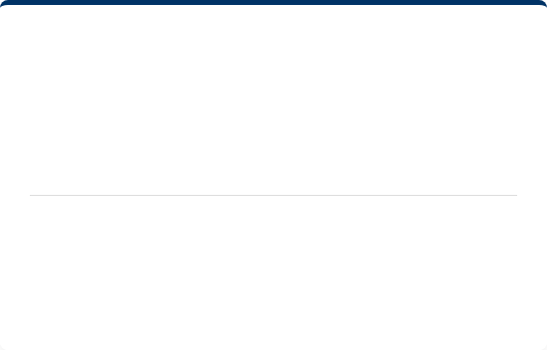
Class Design
Major Classes
Interfaces & Patterns
Class 1: Primary Responsibility
Interface 1: Purpose & Contract
Class 2: Primary Responsibility
Abstract Class: Shared behavior
Class 3: Primary Responsibility
Design Pattern: Singleton / Factory / MVC
Utility Class: Helper methods
Usage: How it's applied in project

Slide 6
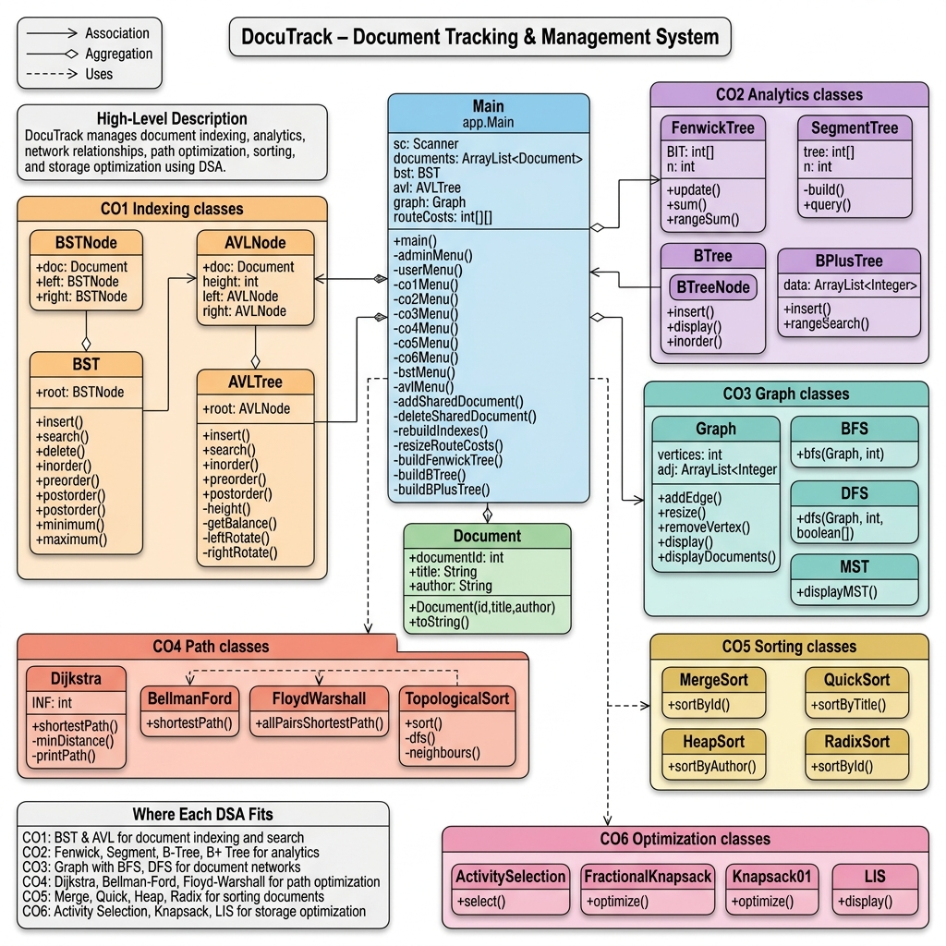

Slide 7




CLI/ Menu Flow
Start DocuTrack
Login Admin/User
Select Module (1-6)
Execute DSA Algorithm
View Computed Result
The user navigates through the menu options to perform operations, generate reports, and save data before exiting.

Slide 8
Next Steps & Deadlines
Task / Milestone | Deadline
Complete Core Module Implementation | July 25th
Integrate File Handling & Storage | July 25th
Exception Handling & Testing | July 25th
Final Report Generation Logic | July 25th
Final Project Submission | July 25th

Slide 9

Thank You!

